Slide 1


Psychology
Year 12 SOCIAL PSYCHOLOGY
PowerPoint Image Slideshow

Slide 2

Social psychology
How does the presence of other people influence the behavior of individuals, dyads, and groups?
History:
Allport’s work on personality paved the way for understanding behaviour
1950s – social psychology became more ‘popular’

Slide 3

What is social psychology?
Social psychology deals with all kinds of interactions between people, spanning a wide range of how we connect: from moments of confrontation to moments of working together and helping others.
Social psychologists believe that an individual’s thoughts, feelings, and behaviors are influenced by social situations.
Intrapersonal topics – emotions and attitudes, the self, and social cognition.
Interpersonal topics – helping behavior, aggression, prejudice and discrimination, attraction and close relationship, and group processes and intergroup relationships.
Figure 12.2 (credit: Sgt. Derec Pierson, U.S. Army)

Slide 4
Situational & Dispositional influences on behavior Heider – attribution theory (motives/reasons behind behavior)
Situational attribution – the view that our behavior and actions are determined by our immediate environment and surroundings.
Used by social psychologists.
Dispositionisal attribution – the view that our behavior is determined by internal factors (attribute of a person such as personality traits and temperament).
Favored in the U.S.
Used by personality psychologists.
Modern social psychologists often consider both the situation and individual.

Slide 5
Heider – attribution theory cont.
Other people are ‘action centres’– others can harm or help us
Dispositional attribution tends to be more common – leading to ‘fundamental attribution error’
-1967 study – student judged attitude held by another based on either essay or speech
-Even though they were assigned which side of debate, more often thought they took that stance
Example: student behaving badly in class (swearing)

Slide 6
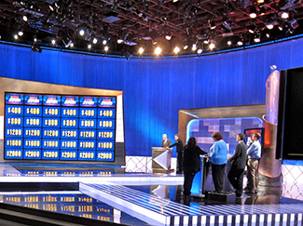
Fundamental attribution error
Fundamental attribution error – tendency to overemphasize internal factors as explanations/attributions for the behavior of other people and underestimate the power of the situation.
People tend to fail to recognize when a person’s behavior is due to situational variables.
Quizmaster Study:
Participants were randomly assigned to play the role of either the questioner or participant.
Questioners developed difficult questions to which they knew the answers.
Participants answered questions correctly 4/10 times.
Participants tended to disregard the influence of the situation and wrongly concluded that a questioner’s knowledge was greater than their own.
Figure 12.3 (credit: Steve Jurvetson)

Slide 7
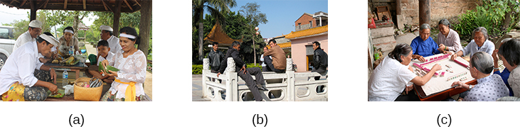
Is the fundamental attribution error a universal phenomenon?
Research suggests that people from an individualistic culture have the greatest tendency to commit the fundamental attribution error.
People from collectivistic cultures, such as some Asian cultures, are more likely to emphasize relationships with others than to focus primarily on the individual. Focusing on others provides a broader perspective including both situation and cultural influences.
Activities such as (a) preparing a meal, (b) hanging out, and (c) playing a game engage people in a group.
Figure 12.4 (credit a: modification of work by Arian Zwegers; credit b: modification of work by "conbon33"/Flickr; credit c: modification of work by Anja Disseldorp)

Slide 8
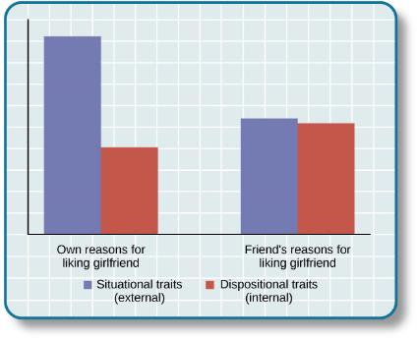
Actor-observer bias
Actor-observer bias – phenomenon of explaining other people’s behaviors are due to internal factors and our own behaviors are due to situational forces.
We often make the fundamental attribution error because we do not have enough information to make a situational explanation about the person’s behavior.
However, when we explain our own behaviors, we have more information available and are more likely to make situational explanations.
One study investigated reasons male participants gave for why they liked their girlfriend.
Actor-observer bias is evident when subjects explain their own reasons for liking a girlfriend (e.g., her personality) versus their impressions of others’ reasons for liking a girlfriend.
Figure 12.5

Slide 9

Self-serving bias – De Michele et. Al.
Self-serving bias – tendency of an individual to take credit by making dispositional or internal attributions for positive outcomes but situational or external attributions for negative outcomes.
Protects self-esteem - allows people to feel good about their accomplishments.
Attribution – a belief about the cause of a result.
One model of attribution proposes three dimensions.
Locus of control – internal vs external.
Stability –extent to which the circumstances are changeable.
Controllability – extent to which the circumstances can be controlled.
When our team wins we make attributions such as it’s talented (internal), works hard (stable), and uses effective strategies (controllable).
When our team loses we might say the other team has more experienced players (external), the other team played at home (unstable), and the weather affected our teams performance (uncontrollable).
Figure 12.6 (Roesch & Amirkham, 1997). (credit: "TheAHL"/Flickr)

Slide 10
Kelley’s ‘General model of attribution’
Need to consider the things before AND after behaviour
Antecedents
Attributions
Consequences
Look at the personal, time and situation factors
Maths test example

Slide 11
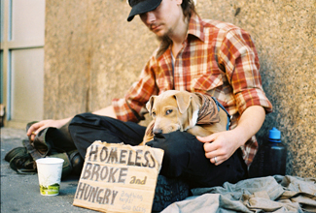
Just world hypothesis
A consequence of the tendency to provide dispositional explanations for behavior is victim blame.
Just-world hypothesis – belief that people get the outcomes they deserve.
Based on the belief that the world is a fair place and therefore good people experience positive outcomes, and bad people experience negative outcomes.
Allows people to feel that the world is predictable and we have some control over life outcomes.
People who hold just-world beliefs tend to blame the people in poverty for their circumstances, ignoring situational and cultural causes of poverty.
Figure 12.7 (credit: Adrian Miles)

Slide 12
Attribution Theory - summary
Limitations
Prior beliefs e.g. stereotypes not taken into account
Why some people consider more complex explanations than others?
Applications
Negative self-serving bias in patients with depression
Attribution of grades to self-esteem and motivation
Sports psychology

Slide 13
SELF-PRESENTATION
SOCIAL ROLES
SOCIAL NORMS
SCRIPTS
ZIMBARDO

Slide 14
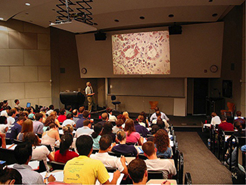
SOCIAL ROLES
Social role – a pattern of behavior that is expected of a person in a given setting or group.
E.g. being a student.
We each have several social roles.
Defined by culturally shared knowledge.
Behavior related to social roles varies across situations.
Being a student is just one of the many social roles you have.
Figure 12.8 (credit: “University of Michigan MSIS”/Flickr)

Slide 15
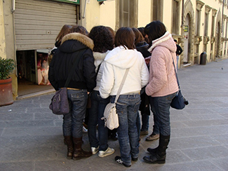
Social norms & scripts
Social norm – a group’s expectation of what is appropriate and acceptable behavior for its members.
How are we supposed to behave and think?
What are we expected to talk about?
What are we expected to wear?
Script – a person’s knowledge about the sequence of events expected in a specific setting.
How do you act when you walk into an elevator, on the first day of school, in a restaurant?
Scripts vary between cultures.
Important sources of information to guide behavior in situations.
Young people struggle to become independent at the same time they are desperately trying to fit in with their peers.
Figure 12.9 (credit: Monica Arellano-Ongpin)

Slide 16
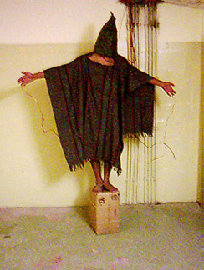
Philip ZIMBARDO
The Stanford Prison Experiment (1971)
Demonstrated the power of social roles, social norms, and scripts.
A mock prison was constructed and participants (male college students), were randomly assigned to play the role of prisoners or guards.
In a very short amount of time, the guards started to harass the prisoner in an increasingly sadistic manner.
Prisoners began to show signs of severe anxiety and hopelessness.
The two week study had to be ended after six days.
Social norms required guards to be authoritarian and prisoners to be submissive.
Scripts influenced the way guards degraded the prisoners by making them do push-ups and removing privacy.
Parallels abuse used by guards in Abu Ghraib prison.
Iraqi prisoners of war were abused by their American captors in Abu Ghraib prison, during the second Iraq war.
Figure 12.10 (credit: United States Department of Defense)

Slide 17
ATTITUDES AND COGNITIVE DISSONANCE

Slide 18
attitude
Attitude – our evaluation of a person, an idea, or an object.
Can be positive or negative.
Influenced by external forces and internal factors that we control.
3 components:
Affective component – feelings.
Behavioral component – the effect of the attitude on behavior.
Cognitive component – belief and knowledge.

Slide 19
Cognitive dissonance
Leon Festinger’s Theory of Cognitive Dissonance
Cognitive dissonance – psychological discomfort arising from holding two or more inconsistent attitudes inc. feelings, behaviors, or cognitions.
Believing cigarettes are bad for your health, but smoking cigarettes anyway, can cause cognitive dissonance.
To reduce cognitive dissonance, individuals can:
Change their behavior - quitting smoking.
Change their belief through rationalization or denial - such as discounting the evidence that smoking is harmful.
Add a new cognition – “Smoking suppresses appetite so I don’t become overweight, which is good for my health”.
Later research found:
Only conflicting cognitions that threaten positive self-image cause dissonance.
Dissonance can also cause physiological arousal and activate brain regions involved in emotions and cognitive functioning.

Slide 20
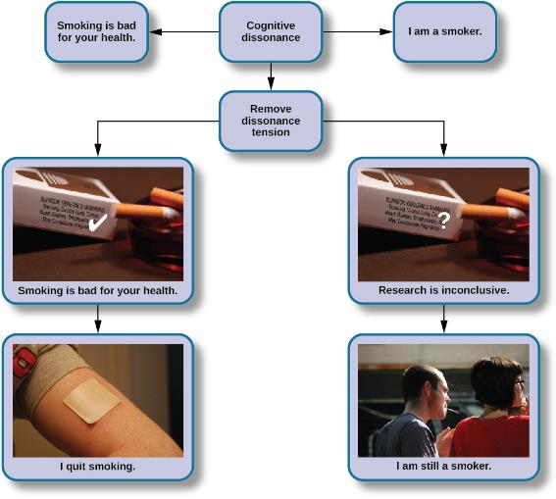
COGNITIVE DISSONANCE
Figure 12.11 (credit “cigarettes”: modification of work by CDC/Debora Cartagena; “patch”: modification of "RegBarc"/Wikimedia Commons; “smoking”: modification of work by Tim Parkinson)

Slide 21
CONFORMITY, COMPLIANCE & OBEDIENCE
SOLOMON ASCH
STANLEY MILGRAM
GROUPTHINK
GROUP POLARIZATION

Slide 22
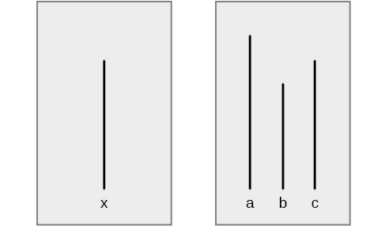
CONFORMITY SOLOMON ASCH
Conformity – the change in a person’s behavior to go along with the group, even if he does not agree with the group.
Asch’s Experiment
These line segments illustrate the judgment task in Asch’s conformity study.
Which line on the right—a, b, or c—is the same length as line x on the left?
Figure 12.17

Slide 23
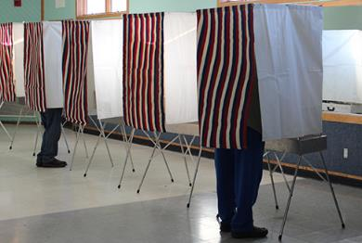
Conformity Solomon Asch
Asch effect – the influence of the group majority on an individual’s judgement.
In Asch’s study there was one naive subject, the rest were confederates who purposely gave the wrong answer. 76% of participants conformed to group pressure at least once by also indicating the incorrect line.
What factors make a person more likely conform?
The size of the majority – the greater the majority, the more likely an individual will conform.
The presence of another dissenter – causes conformity rates to drop to near zero.
The public or private nature of the responses – public responses cause more conformity than private.
Voting for government officials in the United States is private to reduce the pressure of conformity.
Figure 12.18 (credit: Nicole Klauss)

Slide 24
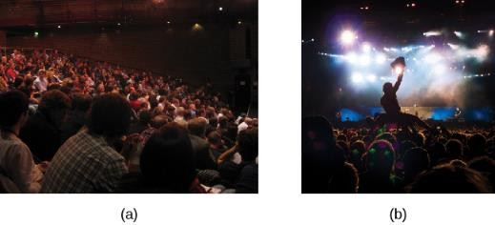
Motivation to CONFORM
Normative social influence – people conform to the group norm to fit in, to feel good, and to be accepted by the group.
Informational social influence – people conform because they believe the group is competent and has the correct information, particularly when the task or situation is ambiguous.
People in crowds tend to take cues from others and act accordingly.
An audience is listening to a lecture and people are relatively quiet, still, and attentive to the speaker on the stage.
An audience is at a rock concert where people are dancing, singing, and possibly engaging in activities like crowd surfing.
Figure 12.19 (credit a: modification of work by Matt Brown; credit b: modification of work by Christian Holmér)

Slide 25
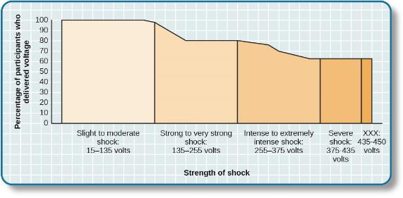
OBEDIENCE STANLEY MILGRAM
Obedience – the change of an individual’s behavior to comply with a demand by an authority figure.
The Milgram experiment showed the surprising degree to which people obey authority.
Participants were told to shock “learners” (confederate) for giving a wrong answer to test items.
Participants believed they were giving the learners shocks, which increased all the way up to 450 volts.
Two out of three (65%) participants continued to administer shocks to an unresponsive learner.
Figure 12.20

Slide 26
GROUPTHINK & group polarization
Groupthink
he modification of the opinions of members of a group to align with what they believe is the group consensus.
Groups often take action that individuals would not perform outside the group setting because groups make more extreme decisions that individuals do.
Members are less likely to express diverse opinions which can lead to faulty decision making.
Group Polarization
The strengthening of an original group attitude after the discussion of views within a group.
Does your opinion change if you find someone attractive, but you friends do not agree?

Slide 27
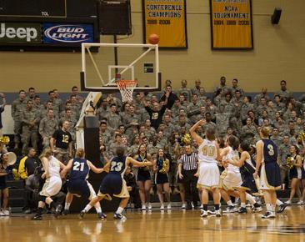
SOCIAL FACILITation & Social loafing
Social Facilitation
Occurs when an individual performs better when an audience is watching than when the individual performs the behavior alone.
Usually occurs when people are performing a task for which they are skilled or an easy task.
However, when people are nervous or less skilled, an audience may hinder rather than help -
Social Inhibition
Presence of others leads to worse performance when completing more complex tasks
Due to complex tasks reaching peak performance at lower arousal compared to simple tasks
E.g. cleaning?
The attention of the crowd can motivate a skilled athlete.
Figure 12.21 (credit: Tommy Gilligan/USMA)

Slide 28
THE BYSTANDER EFFECT
Kitty Genovese (1964)
Attacked and killed with a knife outside her apartment building.
Residents in the apartment building heard her scream for help numerous times but did nothing.
Latane & Darley
Bystander Effect – phenomenon in which a witness/bystander does not volunteer to help a victim or person in distress.
Based on the social situation, not personality variables.
Diffusion of responsibility – tendency for no one in a group to help because the responsibility to help is spread throughout the group.

